Slide 1
TCSS – 554 IR and Search
Slides adopted from Hinrich Schütze, Christina Lioma and Melanie Martin

Slide 2
Today in class
Announcement
Homework 1 is out today
Group Projects
Recap
Review Linear Algebra
Latent Semantic Indexing
Motivation
Procedure
Working Examples

Slide 3
Homework 1 walkthrough

Slide 4
Recap
Things so far……

Slide 5
Relevance and Retrieval Models for Ranking
Boolean Model
Vector Space Model
Query Likelihood Model
Rank
D1
Score = 0.2
D2
D2
Score = 0.7
D3
Document
Collection
Retrieval
Model
D3
Score = 0.5
D1
Introduction to Information Retrieval, Manning et. al. 2009
Notes:
Very verbal

Slide 7
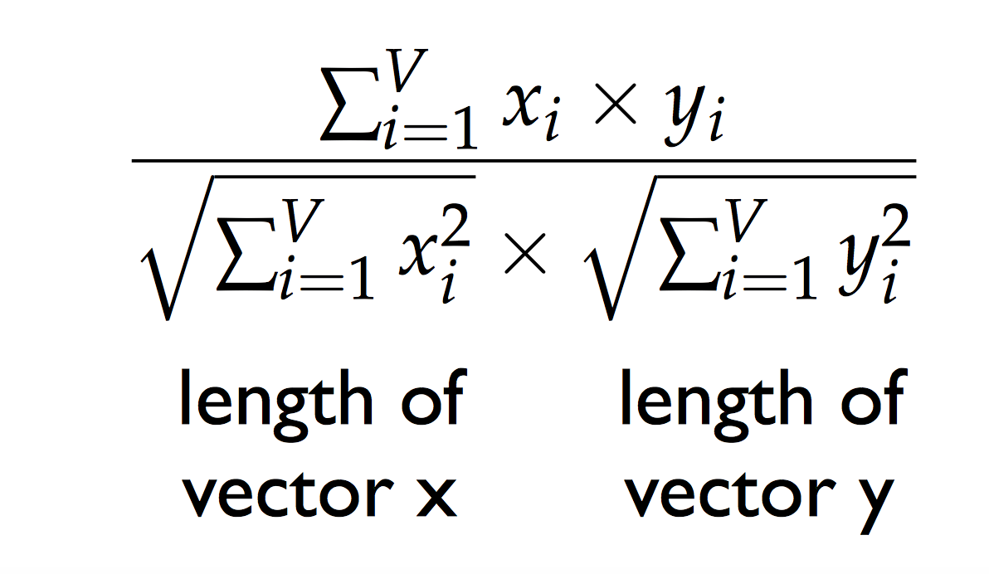
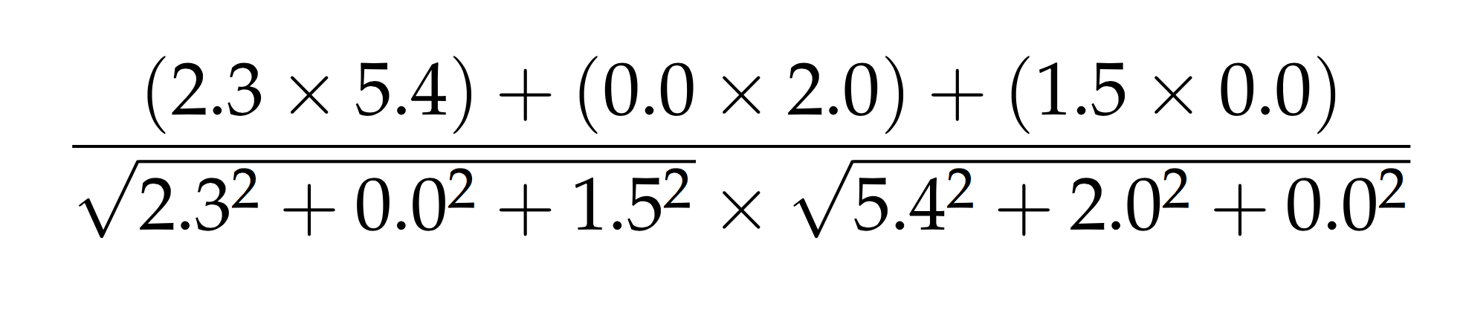
cosine similarity example (tf.idf weights)
cosine( [2.3, 0.0, 1.5] , [5.4, 2.0, 0.0] ) =

Slide 8
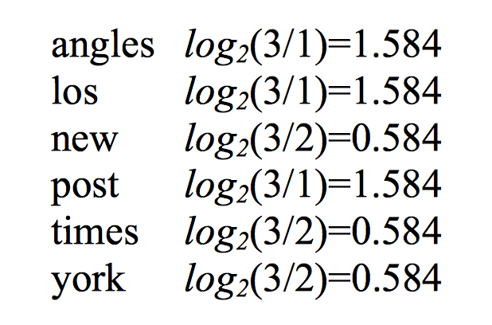
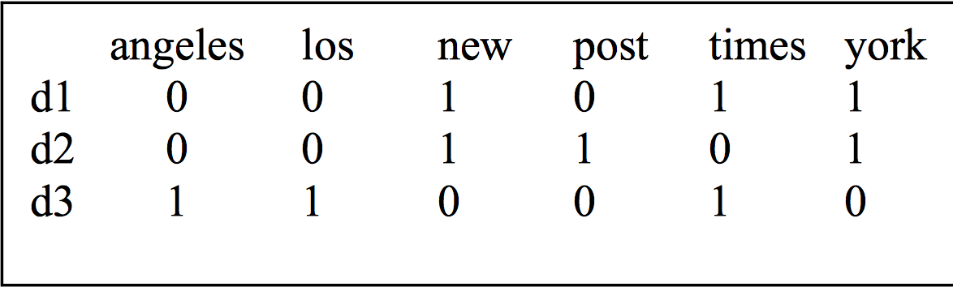
Example: Vector Ranking
IDF
d1: “new york times”
d2: “new york post”
d3: “los angeles times”
Raw TF

Slide 9
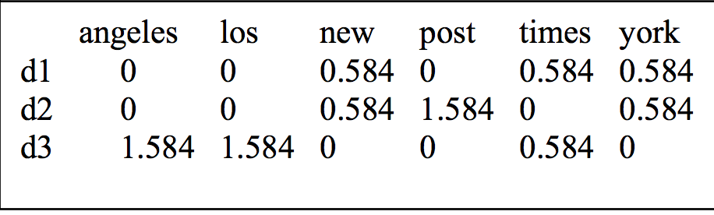
Weighted TFIDF and Query vector
New term document matrix
Query: new new times

Slide 10
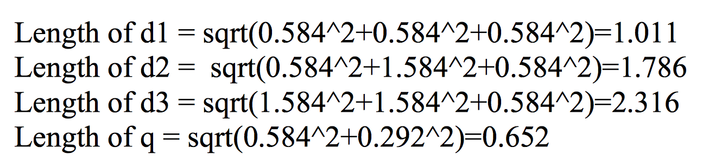
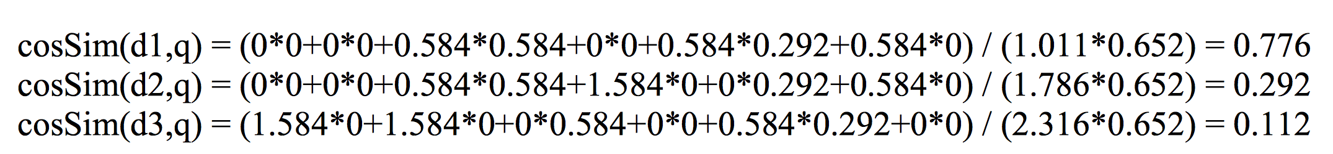
Length and Cosine Similarity
Rank: d1,d2,d3

Slide 11
But why cosine similarity?
What about other distance measures?

Slide 12
Ranking Methods so far….
Ranking
Vector Space
Probabilistic
Boolean
Frequency
Tf-IDF
Scaling (Tf) - IDF)
Language Models
LSI
No Ranking

Slide 13
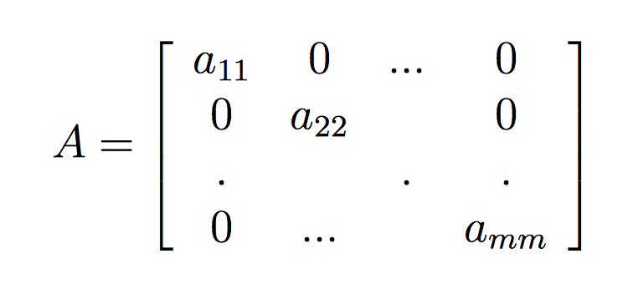
Linear Algebra Review: Diagonal Matrix
A diagonal matrix A is a matrix where all the entries a_{ij} are 0 when i ̸= j.

Slide 14
Linear Algebra Review: Rank of a Matrix
Number of linearly independent rows (or columns).
Eg.
r₃ = 2r₁-r₂
r₄ = -3r₁+ 2r₂
Therefore, only 2 linearly independent rows
r1 and r2.
Therefore, Rank = 2
1 | -2 | 0 | 4
3 | 1 | 1 | 0
-1 | -5 | -1 | 8
3 | 8 | 2 | -12

Slide 15
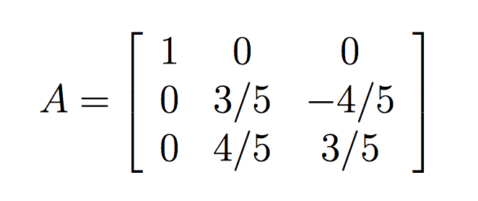
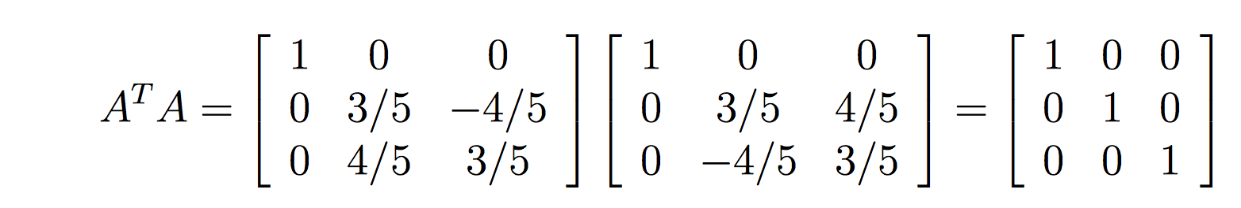
Linear Algebra Review: Orthogonal Matrix
A matrix A is orthogonal if AA^{T} = A^{T}A = I.
Example
Is Orthogonal because

Slide 16
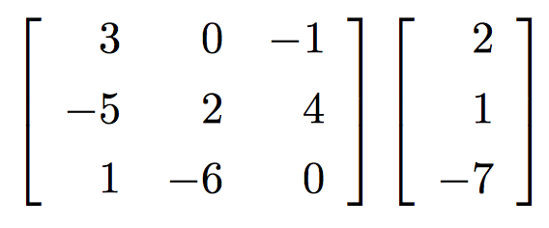
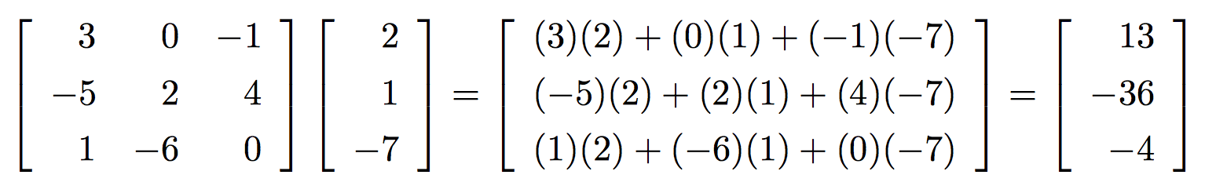
Actions of Matrices on Vectors
A
V
Multiply:

Slide 17
Actions of Matrices on Vectors
Identity Matrix:
The matrix that acts on a vector without actually changing it at all
Rotation Matrix:
A matrix that rotates every vector in R² through a fixed angle θ
Eigenvectors:
A vector whose directions don’t change (other than perhaps reversing) when acted on by by the matrix under consideration. In those cases, the effect of multiplying such a vector by the matrix is the same as multiplying the vector by a scalar.

Slide 18
Linear Algebra Review: Eigenvalues and Eigenvectors
Ax = λx
(λ >1)
Let A be a n×n matrix. The number λ is an eigenvalue of A if there exists a non-zero vector x such that
Ax = λx
vector x is called an eigenvector of A corresponding to λ.
In general, multiplication by a matrix changes the direction of a non-zero vector, unless the vector is special.
Like Ax = λx (for some scalar value of λ)
In such a case, the multiplication by matrix A only stretches or contracts or reverses vector x, but it does not change its direction.
Ax = λx
(0<λ <1)

Slide 19
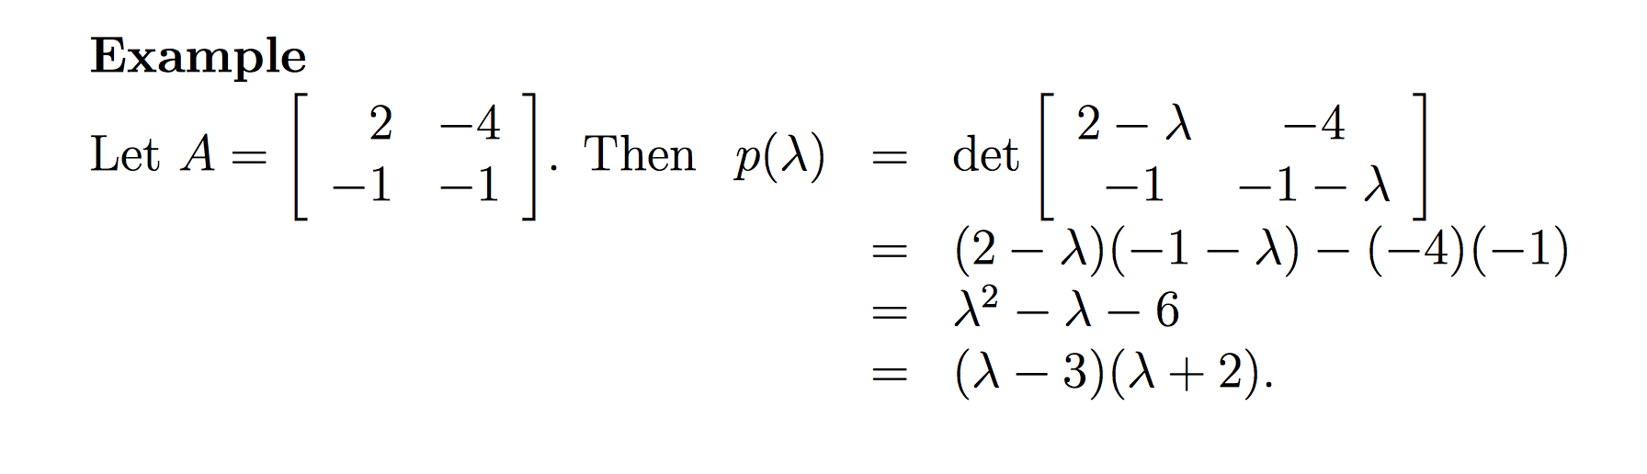
Computing Eigenvalues and Eigenvectors
p(λ) = det(A − λI)
Thus, λ1 = 3 and λ2 = −2 are the eigenvalues of A

Slide 20
Latent semantic indexing

Slide 21
Motivation
R | R | R | R | NR | NR
 | d1 | d2 | d3 | d4 | d5 | d6
internet | 1 | 1 | 0 | 1 | 0 | 0
web | 1 | 0 | 1 | 1 | 0 | 0
surfing | 1 | 1 | 1 | 2 | 1 | 1
beach | 0 | 0 | 0 | 1 | 1 | 1
q
0
1
1
0
2 | 1 | 2 | 3 | 1 | 1

Slide 22
Motivation: Conceptual Solution
Then Sim (q,d1)
= Sim (q,d2)
= Sim (q, d3)
Add missing synonyms to the documents
R | R | R | R | NR | NR
 | d1 | d2 | d3 | d4 | d5 | d6
internet | 1 | 1 | 1 | 1 | 0 | 0
web | 1 | 1 | 1 | 1 | 0 | 0
surfing | 1 | 1 | 1 | 2 | 1 | 1
beach | 0 | 0 | 0 | 1 | 1 | 1
q
0
1
1
0
2 | 2 | 2 | 3 | 1 | 1
The goal of LSI is to do something like this automatically

Slide 23
Limitations of Vector Space Model
Looks for literal term matches
Terms in queries (esp short ones) don’t always capture user’s information need well
Synonymy: many ways to refer to the same object, e.g. car and automobile
Car and automobile
leads to poor recall
Polysemy: most words have more than one distinct meaning, e.g.model, python, chip
Apple (fruit and company)
leads to poor precision

Slide 24
Example
Suppose we have keywords
Car, automobile, driver, elephant
We want queries on car to also get docs about drivers and automobiles, but not about elephants
What if we could discover that the car, automobile and driver directions are strongly correlated, but elephant is not
How? Via correlations observed through documents
If docs A & B don’t share any words with each other, but both share lots of words with doc C, then A & B will be considered similar
E.g A has cars and drivers, B has automobiles and drivers
When you scrunch down dimensions, small differences (noise) gets glossed over, and you get desired behavior

Slide 25
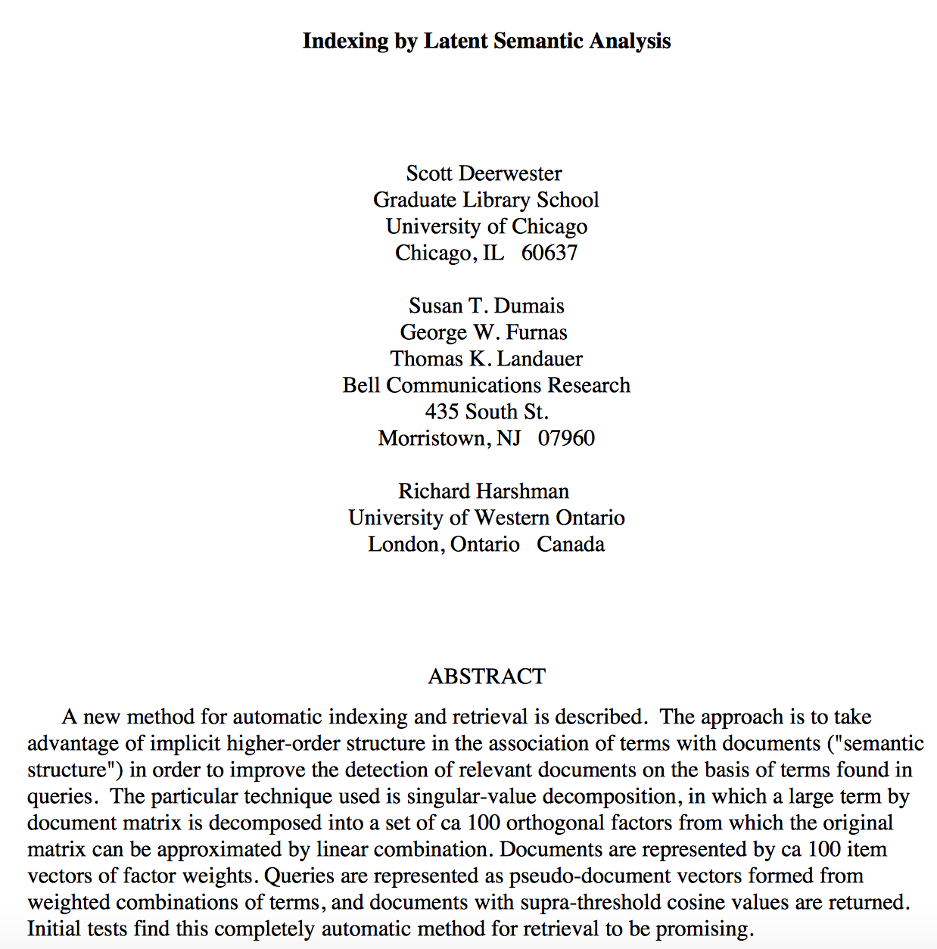
Latent semantic indexing: History
Deerwester, S., Dumais, S., Landauer, T., Furnas, G. and Harshman, R. (1990). ”Indexing by Latent Semantic Analysis”. Journal of the American Society of Information Science 41(6):391-407.

Slide 26
Latent semantic indexing
Is an extension of vector space model
Concepts as dimensions, instead of terms.
Doc1
Query
Doc1
Economics
Query
Term2
Doc2
Doc2
Health
Term3
Sports
Term1

Slide 27
Motivation for LSI
To find and fit a useful model of the relationships between terms and documents.
To find out what terms "really" are implied by a query .
LSI allow the user to search for concepts rather than specific words.
LSI can retrieve documents related to a user's query even when the query and the documents do not share any common terms.
Notes:
LSI MOTIVATION:
The goal in LSI is to find and fit a useful model of the relationships
between terms and documents. We want to use the matrix of observed
occurrences of terms in documents to estimate parameters of that model.
With resulting model we can then estimate what the observed occurrences
really should have been. In this way, for instance, we may be able
to predict that a given term should have been associated with a document,
even though, because of variability in word use, no such association was
observed explicitly.

Slide 28
How LSI Works?
Uses multidimensional vector space to place all documents and terms.
Each dimension in that space corresponds to a concept existing in the collection.
Thus underlying topics of the document is encoded in a vector.
Common related terms in a document and query will pull document and query vector close to each other.

Slide 29
Motivation: Conceptual Solution
Then Sim (q,d1)
= Sim (q,d2)
= Sim (q, d3)
Add missing synonyms to the documents
R | R | R | R | NR | NR
 | d1 | d2 | d3 | d4 | d5 | d6
internet | 1 | 1 | 1 | 1 | 0 | 0
web | 1 | 1 | 1 | 1 | 0 | 0
surfing | 1 | 1 | 1 | 2 | 1 | 1
beach | 0 | 0 | 0 | 1 | 1 | 1
q
0
1
1
0
2 | 2 | 2 | 3 | 1 | 1
The goal of LSI is to do something like this automatically

Slide 30
Motivation: Conceptual Solution
 | d1 | d2 | d3 | d4 | d5 | d6
internet | 1 | 1 | 1 | 1 | 0 | 0
web | 1 | 1 | 1 | 1 | 0 | 0
surfing | 1 | 1 | 1 | 2 | 1 | 1
beach | 0 | 0 | 0 | 1 | 1 | 1
b1 | b2
1 | 0
1 | 0
1 | 1
0 | 1
d1 | d2 | d3 | d4 | d5 | d6
1 | 1 | 1 | 1 | 0 | 0
0 | 0 | 0 | 1 | 1 | 1
=
x
Equivalently: the 4x6 matrix can be written as the the product of 4x2 matrix with 2x6 matrix
B1 and B2 are the underlying concepts
The vectors d1-d6 (in green) are representation of documents in the new (lower dimension) concept space

Slide 31
Goal of LSI
Given the matrix A and rank k, and k<< rank (A)
Then find the matrix A’ of column rank k such that difference between A and A’ is as small as possible.
But, how do we get such an approximation?
Solution: Matrix Factorization (SVD)
Theorem: for any mxn matrix A of rank R, there exists U, S, V, such that
A = U x S x V

Slide 32
LSI-Procedure
Obtain term-document matrix.
Compute the SVD.
Truncate-SVD into reduced-k LSI space.
-k-dimensional semantic structure
Similarity on reduced-space:
-term-term
-term-document
-document-document

Slide 33
Query processing
Map the query to reduced k-space
q’=q^{T}U_{k}S⁻¹_{k},
Retrieve documents or terms within a proximity.
-cosine

Slide 34
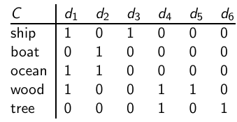
Example of C = UΣV^{T} : The matrix C
This is a Standard term-document matrix. Actually, we use a non-weighted matrix here to simplify the example.

Slide 35
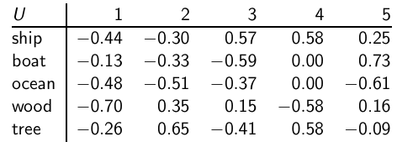
Example of C = UΣV^{T} : The matrix U
This is an orthonormal matrix
Row vectors have unit length
Any two distinct row vectors are orthogonal to each other.
Think of the dimensions as “semantic” dimensions that capture distinct topics like politics, sports, economics.
Each number u_{ij} in the matrix indicates how strongly related term i is to the topic represented by semantic dimension j .

Slide 36
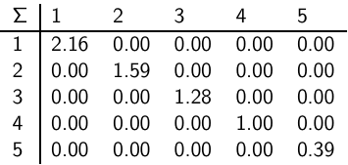
Example of C = UΣV^{T} : The matrix Σ
This is a square, diagonal matrix.
The diagonal consists of the singular values of C.
The magnitude of the singular value measures the importance of the corresponding semantic dimension.
We’ll make use of this by omitting unimportant dimensions.

Slide 37
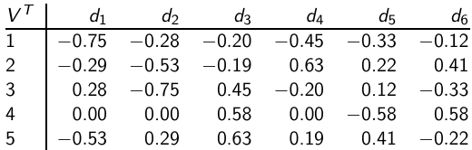
Example of C = UΣV^{T} : The matrix V^{T}
One column per document
one row per min(M,N) where M is the number of terms and N is the number of documents.
Again: This is an orthonormal matrix
Column vectors have unit length.
Any two distinct column vectors are orthogonal to each other.
These are again the semantic dimensions from the term matrix U that capture distinct topics like politics, sports, economics.
Each number v_{ij} in the matrix indicates how strongly related document i is to the topic represented by semantic dimension j.

Slide 38
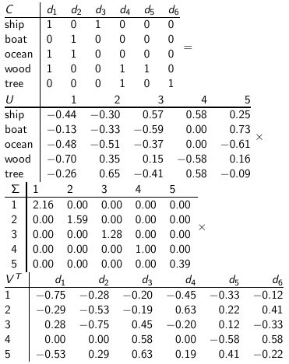
Example of C = UΣV^{T} : All four matrices
38

Slide 39
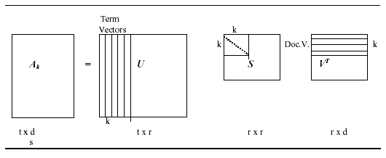
Truncated-SVD
Create a rank-k approximation to A,
k < r_{A} or k = r_{A} ,
A_{k} = U_{k} S_{k} V^{T}_{k}

Slide 40
Truncated-SVD
Using truncated SVD, underlying latent structure is represented in reduced-k dimensional space.
Noise in word usage is eliminated,

Slide 41
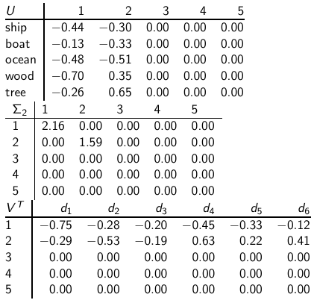
Reducing the dimensionality to 2
41

Slide 42
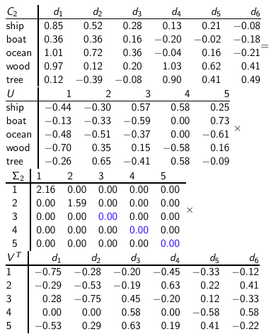
Reducing the dimensionality to 2
42

Slide 43
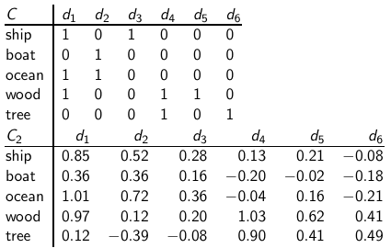
Original matrix C vs. reduced C₂ = UΣ₂V^{T}
We can view
C₂ as a two-dimensional
representation
of the matrix.
We have
performed a
dimensionality
reduction to
two
dimensions.
43

Slide 44
Why the reduced matrix is “better”?
Similarity of d2 and d3 in the original space: 0.
Similarity of d2 und d3 in the reduced space:
0.52 * 0.28 + 0.36 * 0.16 + 0.72 * 0.36 + 0.12 * 0.20 + - 0.39 * - 0.08 ≈ 0.52
44

Slide 45
Why the reduced matrix is “better”
“boat” and “ship” are semantically similar. The “reduced” similarity measure reflects this.
Dot product of ship and boat
= 0 in C
But not in C2
45

Slide 46
Example with Query

Slide 47
A “collection” consists of the following “documents”:
d1: Shipment of gold damaged in a fire.
d2: Delivery of silver arrived in a silver truck.
d3: Shipment of gold arrived in a truck.
Suppose that we use the term frequency as term weights and query weights. The following document indexing rules are also used:
stop words were not ignored
text was tokenized and lowercased
no stemming was used
terms were sorted alphabetically
Suppose query: “gold silver truck.”

Slide 48
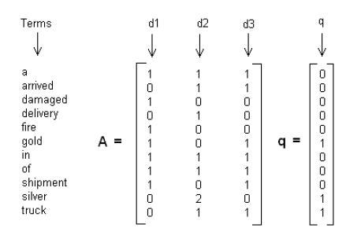
Step 1

Slide 49
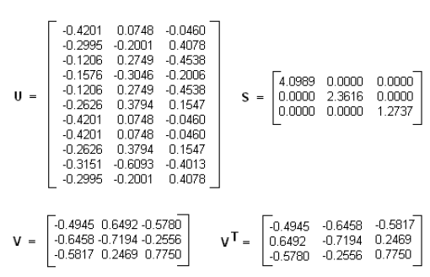
Step 2
Decompose matrix A matrix and find the U, S and V matrices

Slide 50
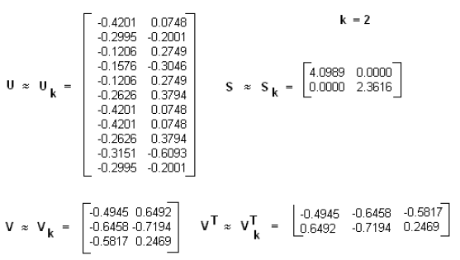
Step 3:
Rank Approximate to 2

Slide 51
Step 4:
Find the new document vector coordinates in this reduced 2-dimensional space.
Rows of V holds eigenvector values. These are the coordinates of individual document vectors, hence
d1(-0.4945, 0.6492)
d2(-0.6458, -0.7194)
d3(-0.5817, 0.2469)

Slide 52
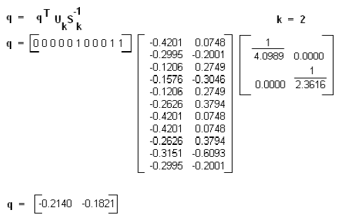
Step 5:
Find the new query vector coordinates in the reduced 2-dimensional space.
q = q^{T}U_{k}S_{k}⁻¹

Slide 53
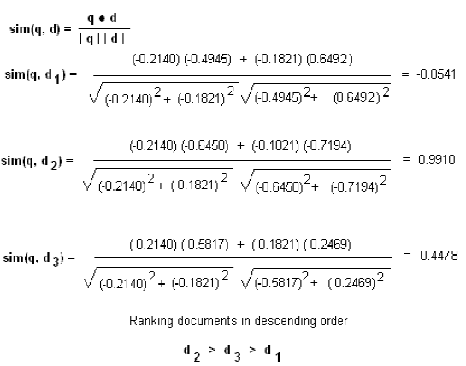
Step 6:
Rank documents in decreasing order of query-document cosine similarities.

Slide 54
Why we use LSI in information retrieval
LSI takes documents that are semantically similar (= talk about the same topics), . . .
. . . but are not similar in the vector space (because they use different words) . . .
. . . and re-represents them in a reduced vector space . . .
. . . in which they have higher similarity.
Thus, LSI addresses the problems of synonymy and semantic relatedness.
Standard vector space: Synonyms contribute nothing to document similarity.
Desired effect of LSI: Synonyms contribute strongly to document similarity.

Slide 55
Recap
Recap
Review Linear Algebra
Latent Semantic Indexing
Motivation
Overview
Working Example
Dimensionality Reduction
Next Class
PageRank
Homework

